Slide 1
End-to-End Retail Performance and Behavioral Analytics
Company Name: RetailNova Inc.
Industry: Retail & E-Commerce
Presented by
Abhinav Davu

Slide 2
Agenda
Introduction
Objectives
Methodology
Data Collection
Data Cleaning
SQL Analysis
Data Visualization
Challenges
Conclusion

Slide 3
Introduction
Retail businesses generate vast amounts of data across sales, customers, products, stores, and returns. This project focuses on transforming raw data into meaningful insights for better business decisions. Project analyzes retail business data for actionable insights.
Combines sales, customer, product, store, and return datasets
Uses systematic data cleaning and visualizations
Supports better decision-making and business growth

Slide 4
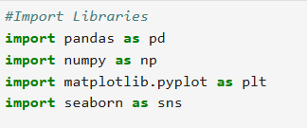
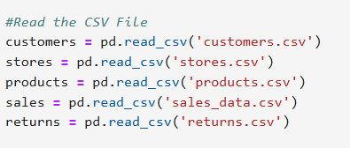
Methodology Data Reading:
Load sales, customer, product, store, and return data from CSV files into Python for analysis.
Tools used: Python (pandas), Jupyter Notebook for reading and inspecting data.

Slide 5
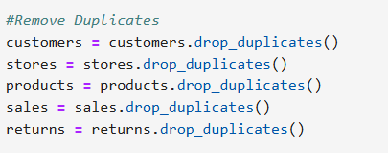
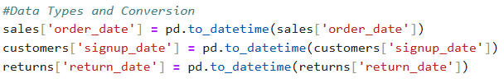
Data Cleaning:
Handle missing values, convert column types, and create calculated features (profit, age group, etc.).
Convert data types (e.g., dates, numbers) to ensure consistency across datasets.

Slide 6
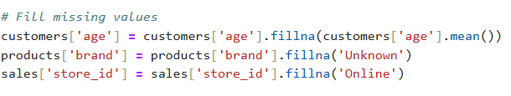
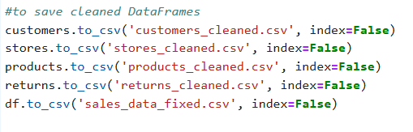
Filling the missing values across the datasets.
Saving the cleaned Dataset.

Slide 7
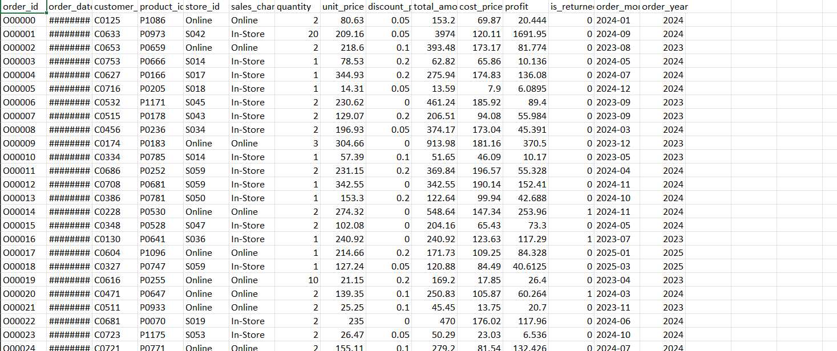
Cleaned Excel file:

Slide 8
SQL Analysis
Table Design & Relationships: Define table schema, set primary/foreign keys, and establish relationships between customers, products, sales, stores, and returns.
Data Validation: Check to ensure sales and returns reference valid customer/product/store IDs.
Import Cleaned Data: Load cleaned datasets (CSV) into MySQL database tables.
Answering the Business questions.
Import cleaned data into MySQL and perform advanced queries for business analysis and data aggregation using SQL.

Slide 9
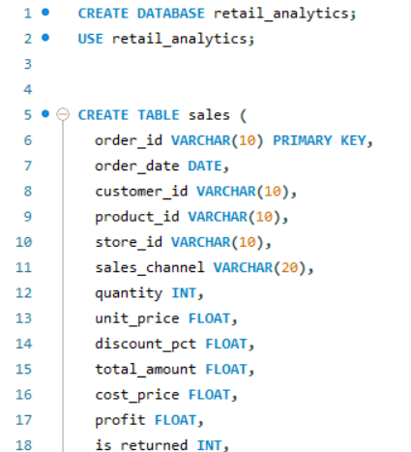
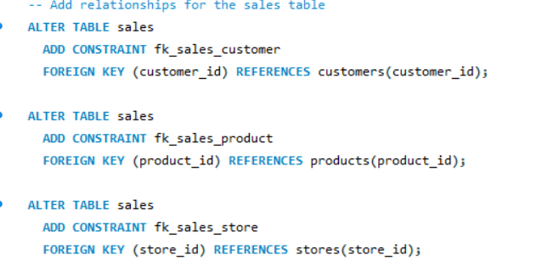
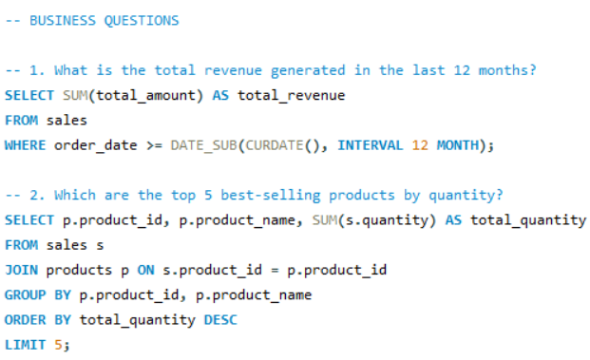

Slide 10
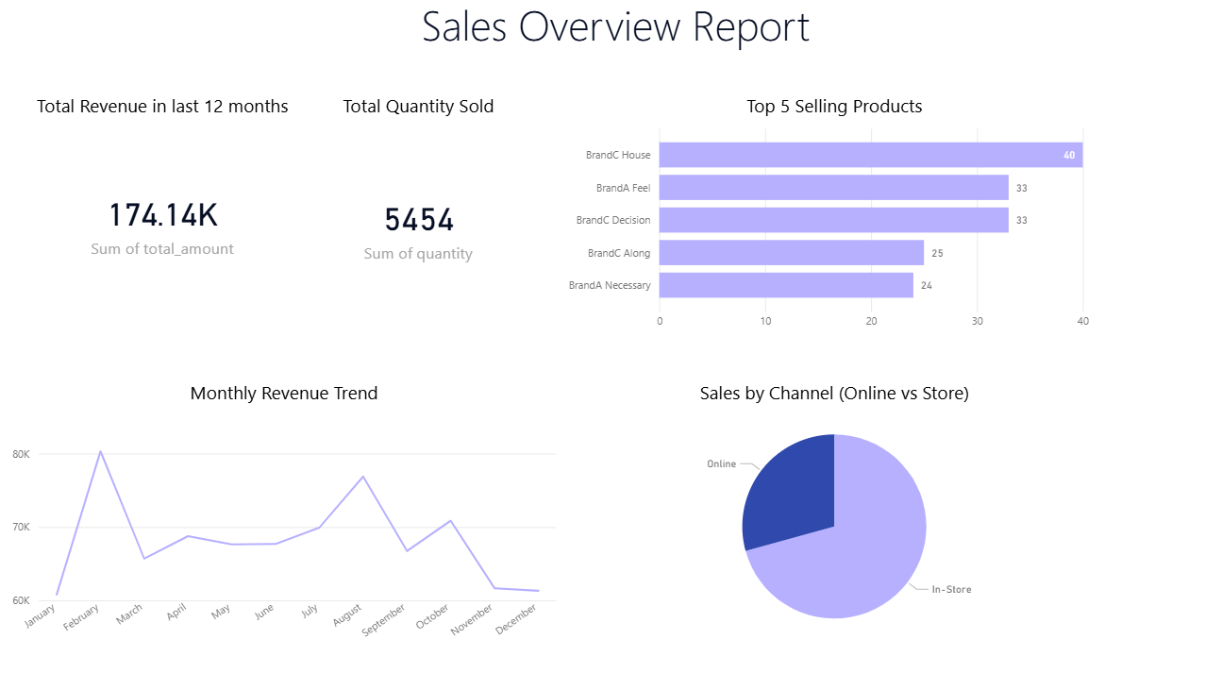
Data Visualization:
Building interactive dashboards to display trends and uncover business insights.
Tools used: Power BI for dashboards; charts and plots created with Python (matplotlib, seaborn) as needed.

Slide 11
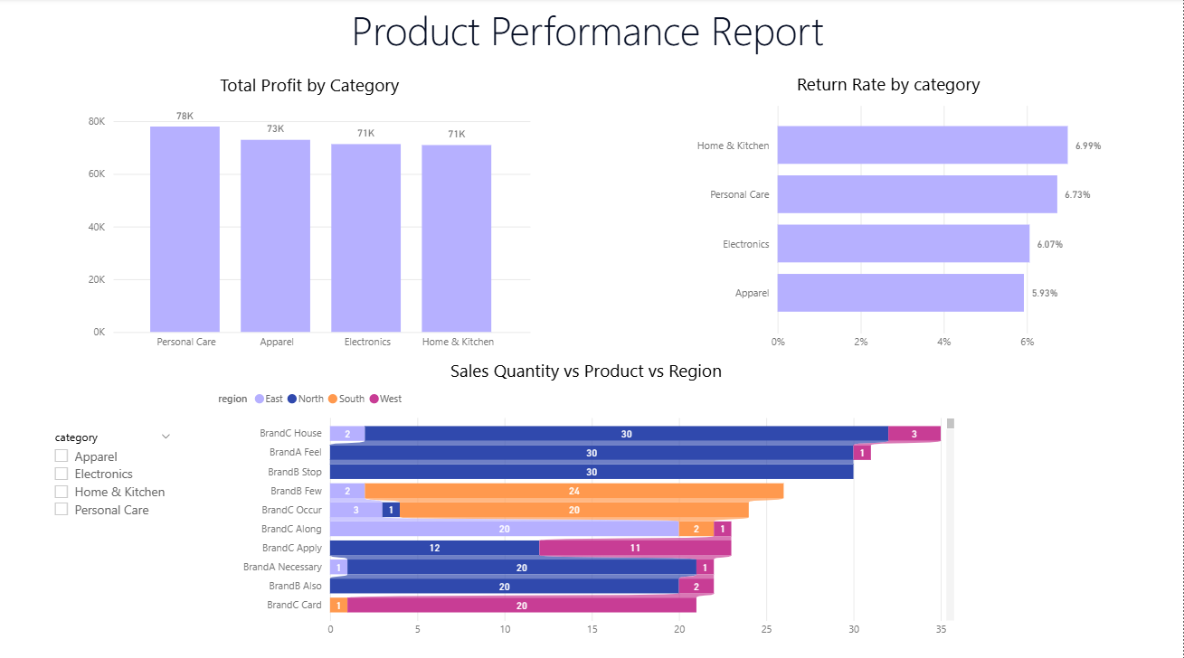

Slide 12
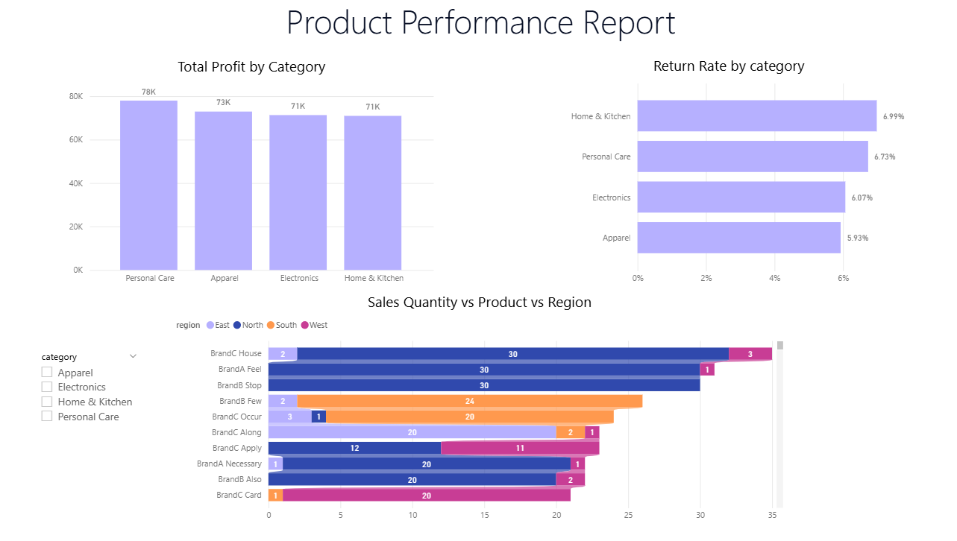

Slide 13
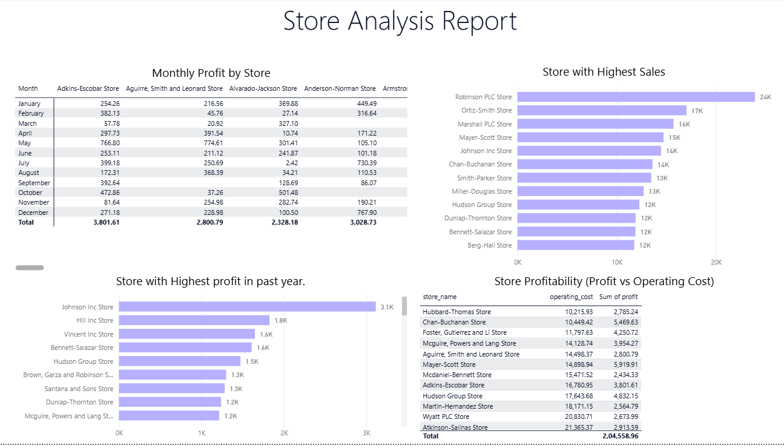

Slide 14
Challenges:
Data Quality Issues
Encountered missing, duplicate, and inconsistent customer/store/product information across multiple files.
Required significant cleaning and validation to ensure data integrity.
Data Integration
Merging datasets from various sources (sales, returns, customers, stores, products) was complex due to mismatched IDs and inconsistent schema.
Handling Missing Values
Had to decide on suitable imputation strategies (e.g., using mean, median, or ‘unknown’ for filling gaps) without distorting business meaning.
Date and Time Formatting
Standardizing different date formats, handling null dates, and ensuring correct types for time-based analysis.

Slide 15
Conclusion:
This project successfully demonstrated the end-to-end process of cleaning, integrating, and analyzing retail business data using Python and advanced dashboard tools. Despite encountering challenges in data quality, integration, and visualization, key business metrics were extracted and visualized to deliver actionable insights
Overall, the project improved data reliability and provided a foundation for ongoing business analytics and strategic growth.

Slide 16
Thank You

